Slide 1
Dataset Analysis for Movie Ratings Based on Different Personality Types
TEAM MEMBERS
AKHIL KUMAR PODILA
VISHAL GOYAL
SNEHA DUBEY
PRITESH SHEWALE

Slide 2


INTRODUCTION
Movie ratings based on the personality type
This dataset has five distinct personality types as mentioned below:
Openness
Agreeableness
Emotional Stability
Conscientiousness
Extraversion
Rating Scale is 1 to 7 where 1 is lowest and 7 is highest
Assigned_metric and Assigned_condition shows different genre of movies
Finally dataset shows relation between personality types and movie ratings

Slide 3
How does this project help those who are interested in this topic?
Movie Makers/ Production Houses
Writers
General Audience (Viewers)
Censor Board

Slide 4
Data Set Selection:
Dataset is from Kaggle which has huge set of information different types of attributes so it can be useful for prediction and classification.
Dataset allows unique kind of analysis and classification for finding psychological behavior of people for movie selection.

Slide 5

Data for Project:
This dataset has 1820 Unique Values
Data Cleaning Process
Fields used are as below :
User_id
Openness
Agreeableness
Emotional_Stability
Conscientiouness
Extraversion
Assigned_matrics
Assigned_Conditions
Is_personalized
Avg_movie_ratings
The original .csv file had 1820 users which rated 12 movies
The data cleaning process consists of merging of two .csv fields to get rid of access fields which and take out the average of ratings given by the users for all the movies.
The new field which has the average of the ratings for movies is called “avg_movie_ratings”.
The dataset used “assigned_matrics” and “assigned_conditions” to categorize different types of movies.

Slide 6
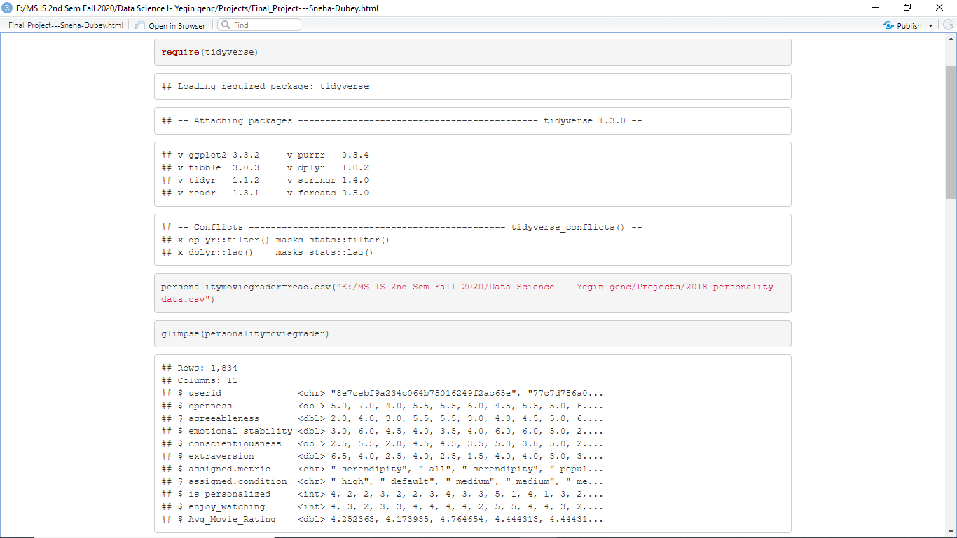
Loaded Dataset using R Studio :

Slide 7
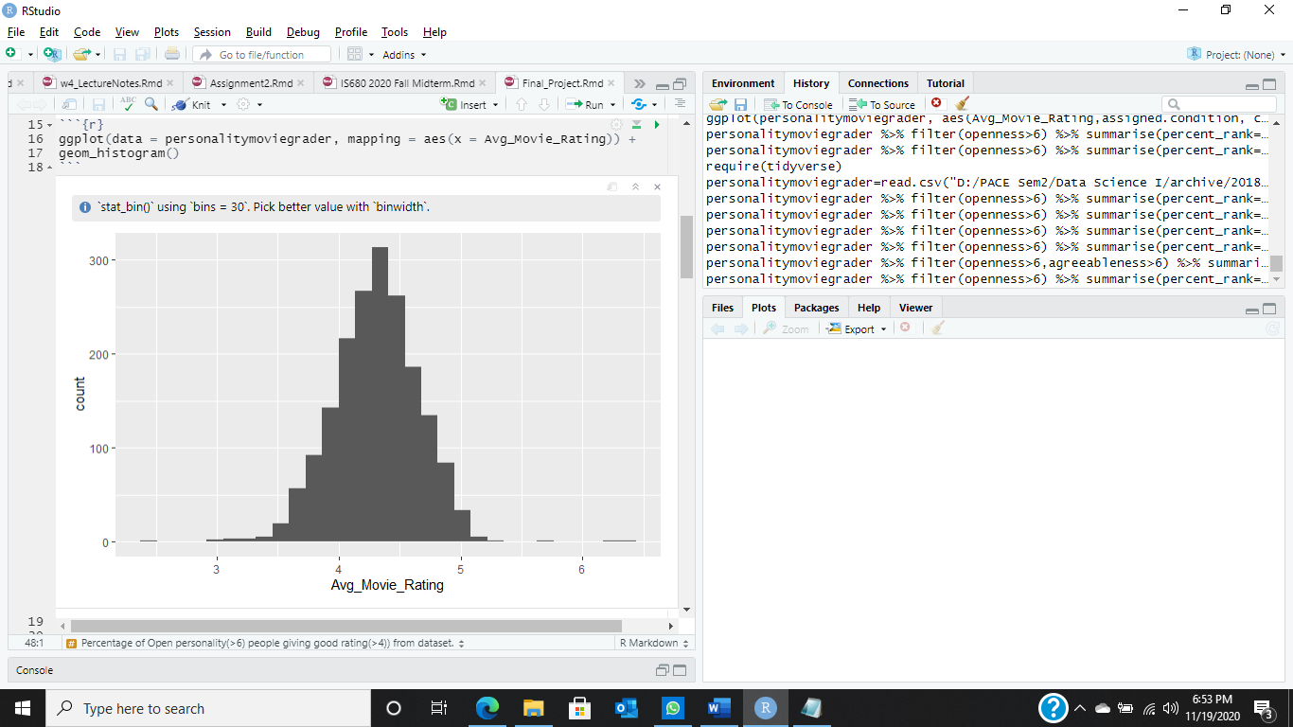
Analysis 1: Histogram to show the data variety in the dataset of average movie ratings?

Slide 8

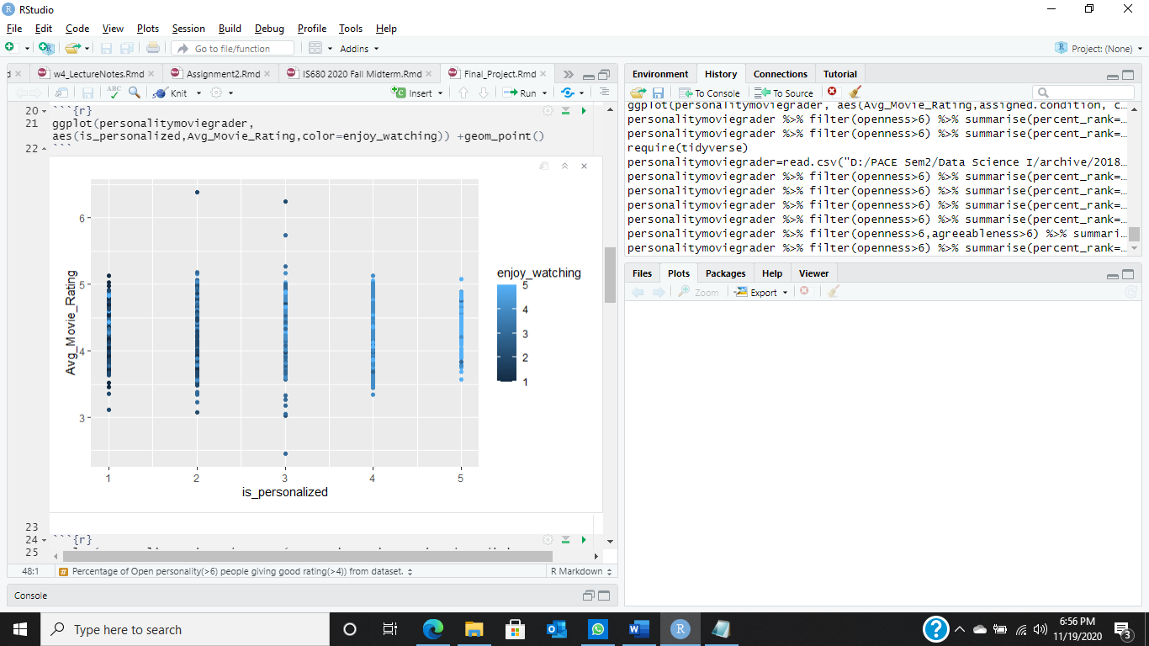
Analysis 2: Using the graph of “Is_personalized” (Movie set) VS “avg_movie_ratings” considering “enjoy_watching” (User enjoy the selected personalized movie set) we want to analyse how the given different personalities user rate the movies?

Slide 9


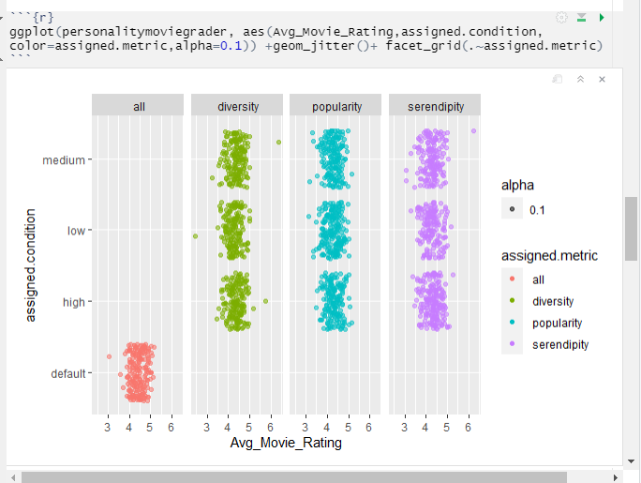
Analysis 3: Analysis for Average movie rating VS different types of movies?

Slide 10
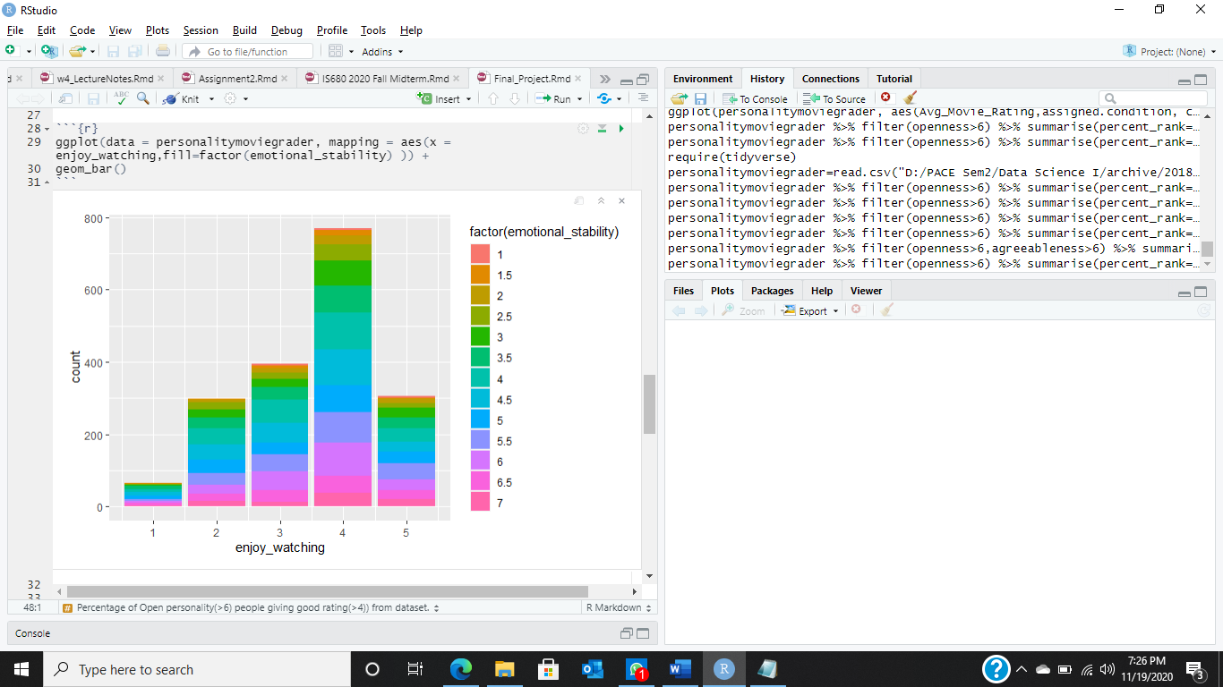
Analysis 4: Exploring data for movies enjoyed by users with colour coding of emotional stability of users?

Slide 11
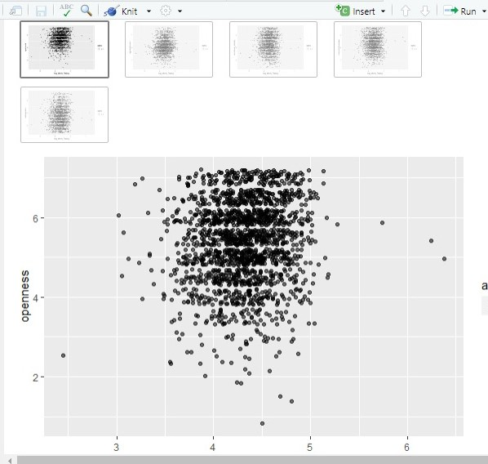
Analysis 5: Study the comparison between how all the different types of personalities rates the movies
Conclusion : openness people data clustering is shown more higher

Slide 12


Conclusion:
This is one of the most basic analysis done on this dataset which gives us a clear percentage value using the R query. But looking at histogram it shows that most of the data for movie rating given by all the users clustered between rating 4 and 5.
Hence, we completed the Exploratory Data Analysis to study this Dataset.

Slide 13
THANK YOU

